Slide 1
THE LIFE OF CHRIST
PART 71

Slide 2
Mark 10:13 Then they brought little children to Him, that He might touch them; but the disciples rebuked those who brought them. ¹⁴ But when Jesus saw it, He was greatly displeased and said to them, "Let the little children come to Me, and do not forbid them; for of such is the kingdom of God. ¹⁵ "Assuredly, I say to you, whoever does not receive the kingdom of God as a little child will by no means enter it."

Slide 3
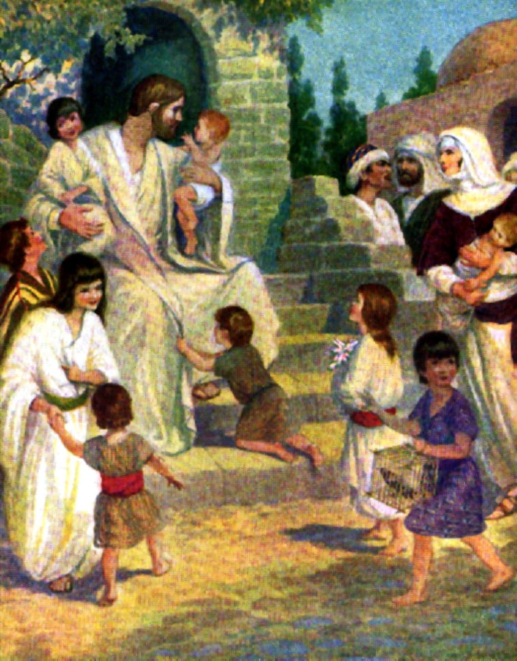
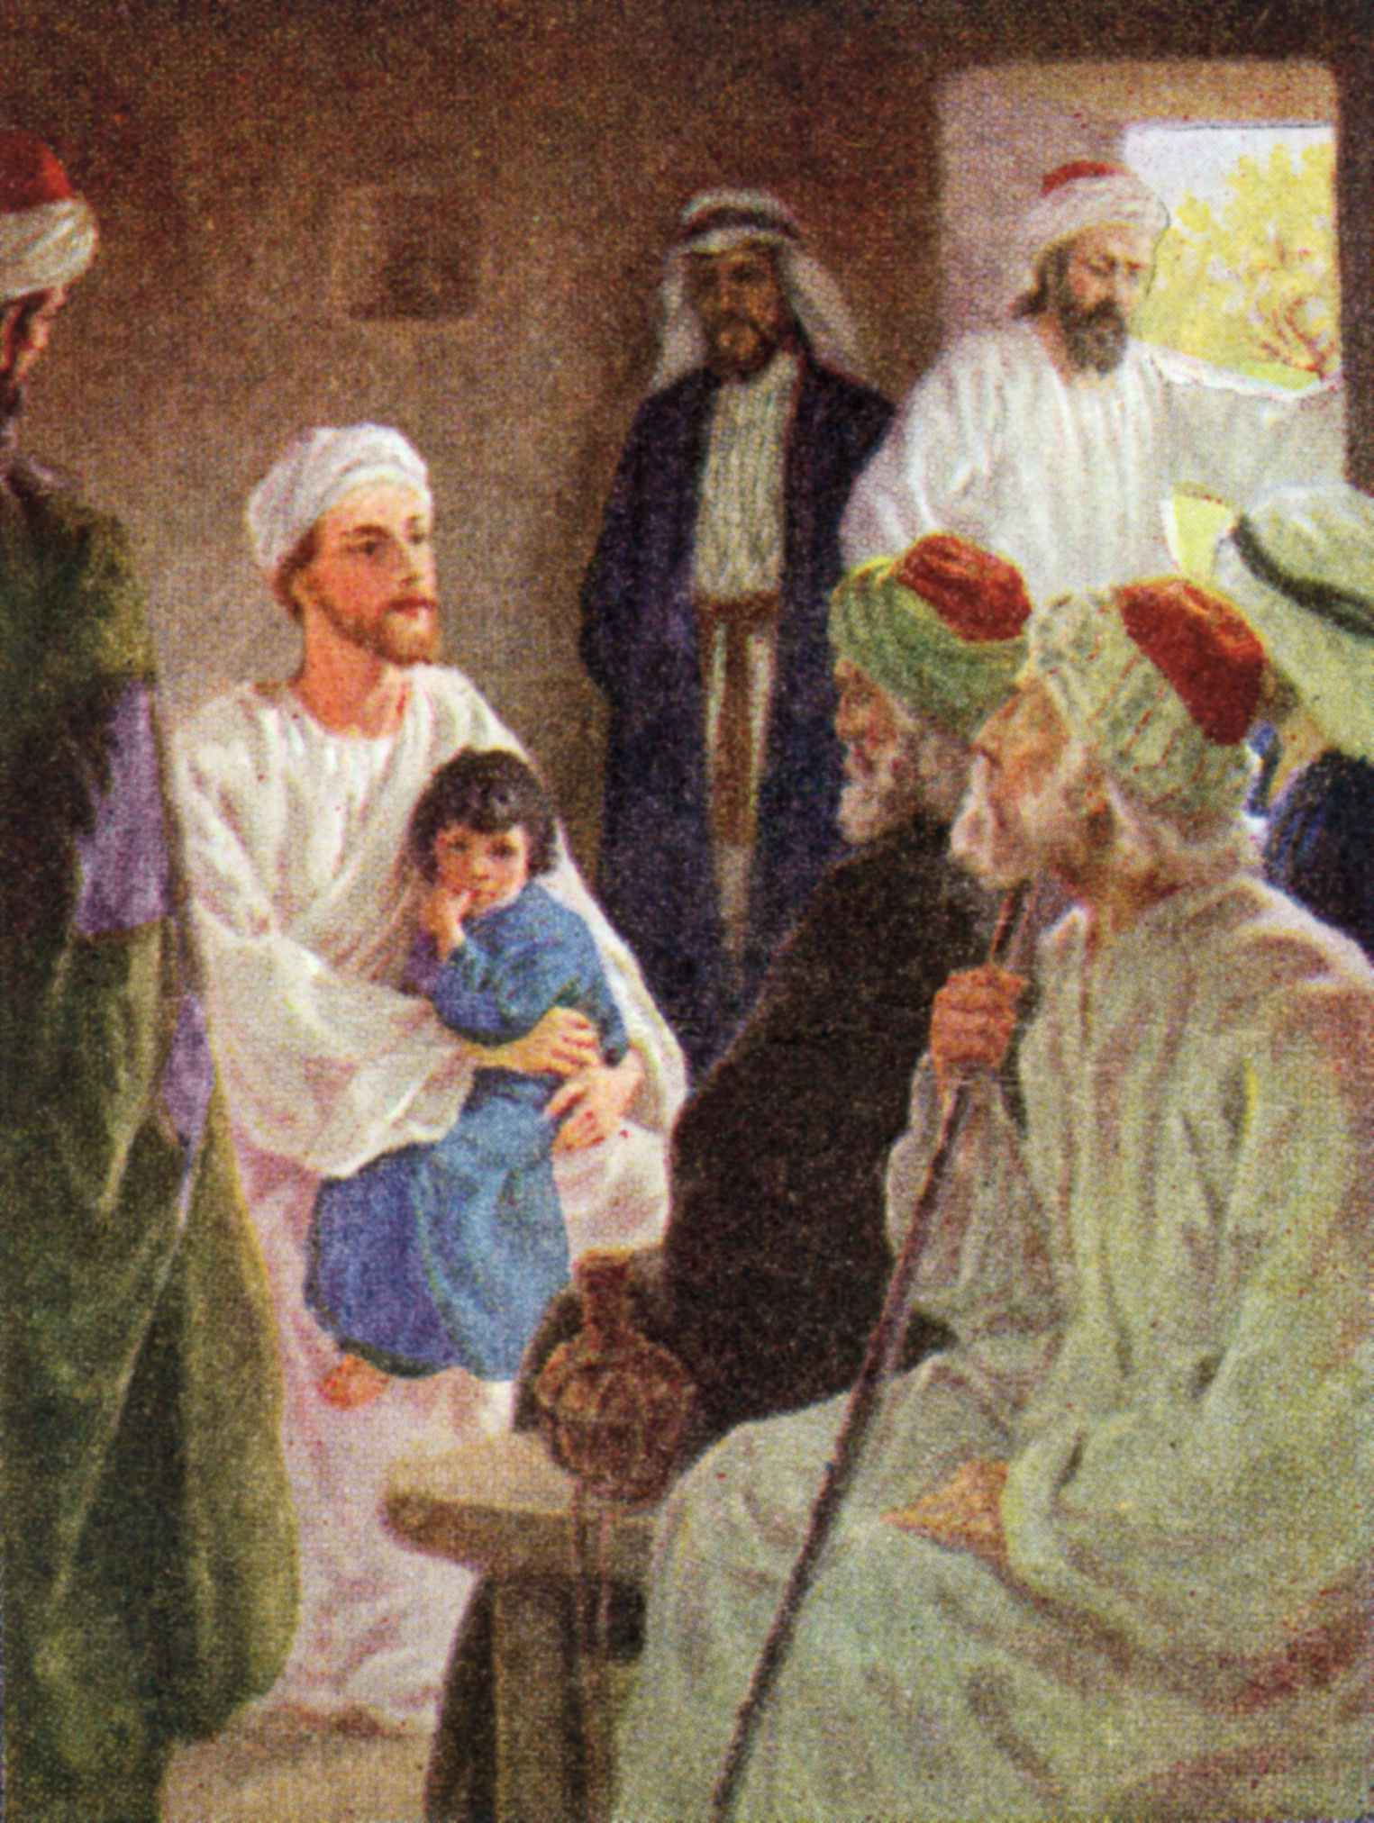

Slide 4
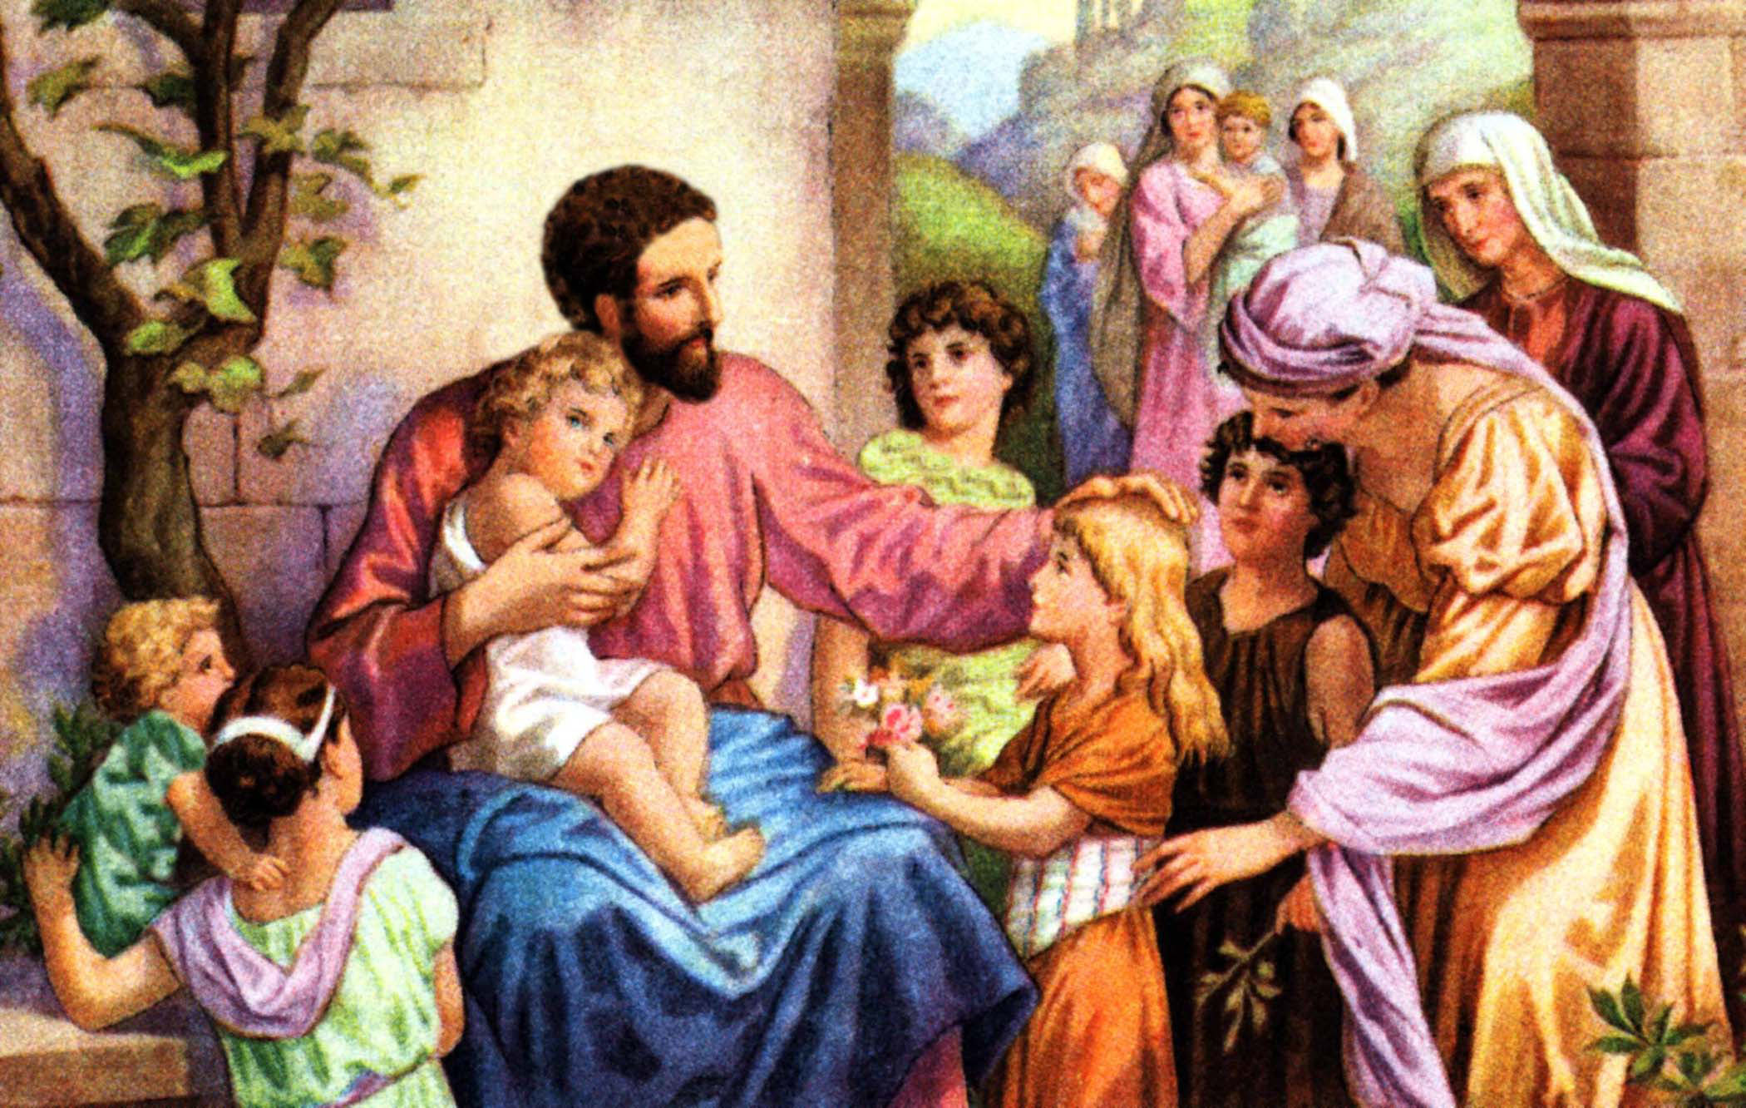

Slide 5
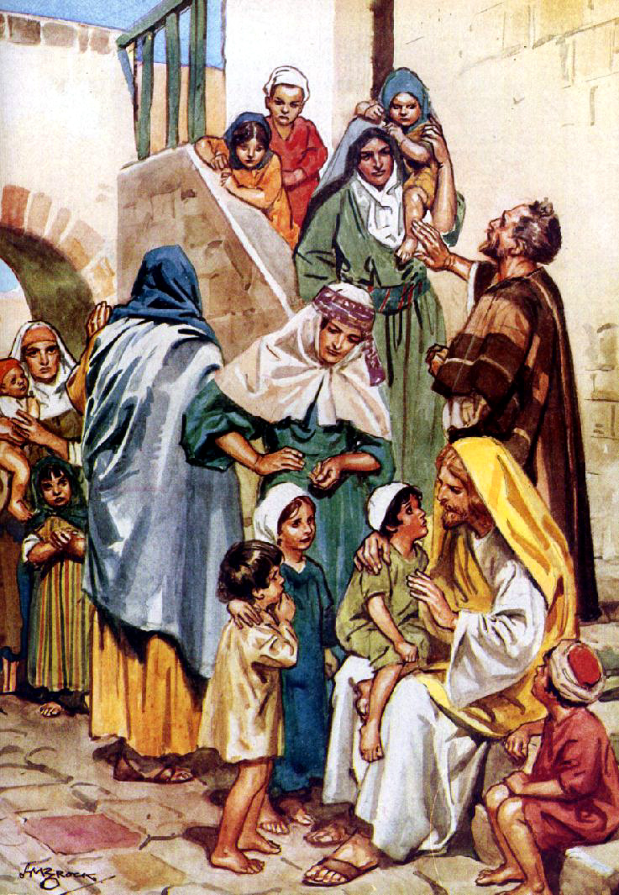

Slide 6
Genesis 48:14 Then Israel stretched out his right hand and laid it on Ephraim's head, who was the younger, and his left hand on Manasseh's head, guiding his hands knowingly, for Manasseh was the firstborn. ¹⁵ And he blessed Joseph, and said: "God, before whom my fathers Abraham and Isaac walked, The God who has fed me all my life long to this day, ¹⁶ The Angel who has redeemed me from all evil, Bless the lads; Let my name be named upon them, And the name of my fathers Abraham and Isaac; And let them grow into a multitude in the midst of the earth."

Slide 7
There was likewise a beautiful custom in Jerusalem to train their young sons and daughters to afflict themselves on a fast day: at the age of eleven to the middle of the day, at the age of twelve the full day, and at the age of thirteen [the boy] was taken round and presented to every elder to bless him and pray for him that he may be worthy to study the Torah and engage in good deeds. (Talmud Soferim 18.5)

Slide 8
¹⁶ And He took them up in His arms, put His hands on them, and blessed them.

Slide 9
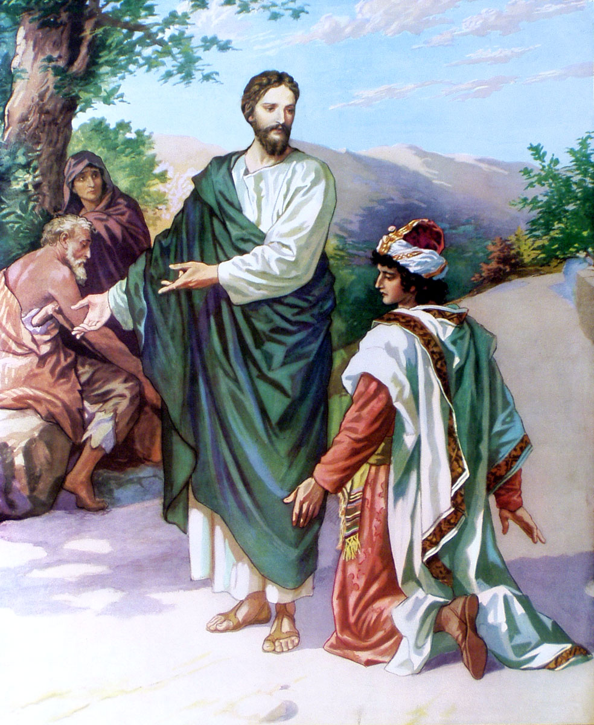
Mark 10:17 Now as He was going out on the road, one came running, knelt before Him, and asked Him, "Good Teacher, what shall I do that I may inherit eternal life?"

Slide 10
¹⁸ So Jesus said to him, "Why do you call Me good? No one is good but One, that is, God. ¹⁹ "You know the commandments: 'Do not commit adultery,' 'Do not murder,' 'Do not steal,' 'Do not bear false witness,' 'Do not defraud,' 'Honor your father and your mother.' "

Slide 11
Mark 10:20 And he answered and said to Him, "Teacher, all these things I have kept from my youth."

Slide 12
Mark 10:21 Then Jesus, looking at him, loved him, and said to him, "One thing you lack: Go your way, sell whatever you have and give to the poor, and you will have treasure in heaven; and come, take up the cross, and follow Me."

Slide 13
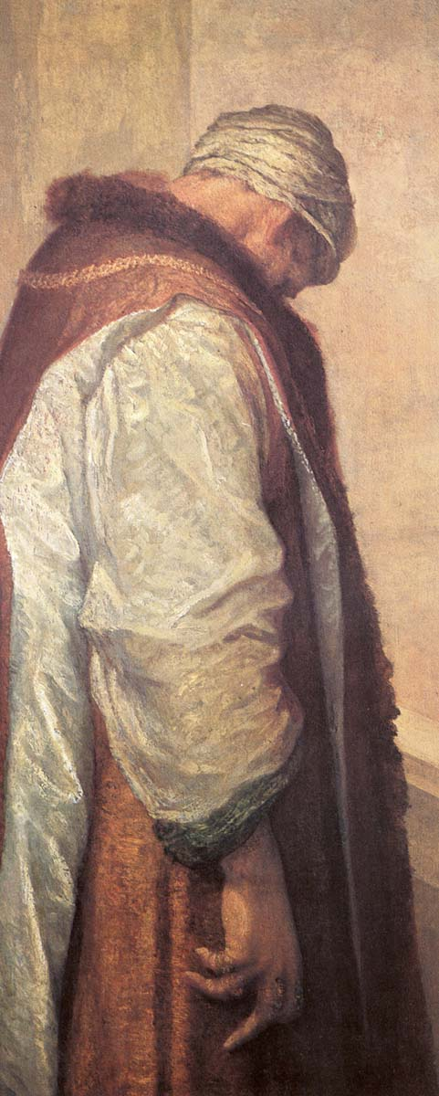
Mark 10:22 But he was sad at this word, and went away sorrowful, for he had great possessions.

Slide 14
Mark 10:23 Then Jesus looked around and said to His disciples, "How hard it is for those who have riches to enter the kingdom of God!" ²⁴ And the disciples were astonished at His words. But Jesus answered again and said to them, "Children, how hard it is for those who trust in riches to enter the kingdom of God! ²⁵ "It is easier for a camel to go through the eye of a needle than for a rich man to enter the kingdom of God."

Slide 15
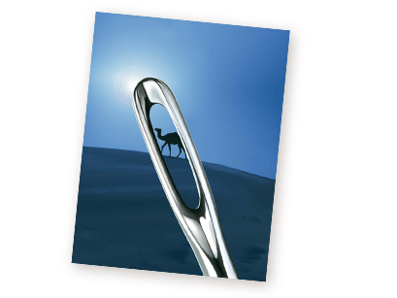

Slide 16
Mark 10:26 And they were greatly astonished, saying among themselves, "Who then can be saved?"

Slide 17
Mark 10:27 But Jesus looked at them and said, "With men it is impossible, but not with God; for with God all things are possible."

Slide 18
Matthew 19:27 Then Peter answered and said to Him, "See, we have left all and followed You. Therefore what shall we have?" ²⁸ So Jesus said to them, "Assuredly I say to you, that in the regeneration, when the Son of Man sits on the throne of His glory, you who have followed Me will also sit on twelve thrones, judging the twelve tribes of Israel. ²⁹ "And everyone who has left houses or brothers or sisters or father or mother or wife or children or lands, for My name's sake, shall receive a hundredfold, and inherit eternal life. ³⁰ "But many who are first will be last, and the last first.

Slide 19
The second view equates the term “regeneration” with the heavenly state, or “the age to come.” This language appears in the parallel passages (M, . 10:30; Lk. 18:30). While it is true that Christ presently reigns and will one day turn the kingdom over to the Father (1 Cor. 15:24), He will also reign with the Father through eternity (Rev. 22:3). The term “regeneration,” then, refers to “a new heaven and a new earth” (Rev. 21:1-5; see IS. 65:17; 6622; Rom. 8:18-25; 2 Pet. 3:13). “The twelve tribes of Israel” refers to all the saved of the heavenly realm over which the twelve apostles right (see 1 Cor. 6:2, 3; 2 Tim. 2:12; Rev. 3:21; 21:9-14). P.175-176

Slide 20
Matthew 20:1 "For the kingdom of heaven is like a landowner who went out early in the morning to hire laborers for his vineyard.

Slide 21
Acts 6:7 Then the word of God spread, and the number of the disciples multiplied greatly in Jerusalem, and a great many of the priests were obedient to the faith.

Slide 22
Acts 17:6 These who have turned the world upside down have come here too.

Slide 23
Luke 10:2 "The harvest truly is great, but the laborers are few; therefore pray the Lord of the harvest to send out laborers into His harvest.

Slide 24
1 Corinthians 15:58 Therefore, my beloved brethren, be steadfast, immovable, always abounding in the work of the Lord, knowing that your labor is not in vain in the Lord.

Slide 25
Matthew 16:16 Simon Peter answered and said, "You are the Christ, the Son of the living God." ¹⁷ Jesus answered and said to him, "Blessed are you, Simon Bar-Jonah, for flesh and blood has not revealed this to you, but My Father who is in heaven. ¹⁸ "And I also say to you that you are Peter, and on this rock I will build My church, and the gates of Hades shall not prevail against it.

Slide 26
We are not added to the vineyard/kingdom of the Lord until we are baptized according to Jn. 3:5 and 1 Cor. 12:13.

Slide 27
Matthew 20:2 "Now when he had agreed with the laborers for a denarius a day, he sent them into his vineyard. ³ "And he went out about the third hour and saw others standing idle in the marketplace, ⁴ "and said to them, 'You also go into the vineyard, and whatever is right I will give you.' So they went. ⁵ "Again he went out about the sixth and the ninth hour, and did likewise. ⁶ "And about the eleventh hour he went out and found others standing idle, and said to them, 'Why have you been standing here idle all day?' ⁷ "They said to him, 'Because no one hired us.' He said to them, 'You also go into the vineyard, and whatever is right you will receive.'

Slide 28
Matthew 20: ⁸ "So when evening had come, the owner of the vineyard said to his steward, 'Call the laborers and give them their wages, beginning with the last to the first.' ⁹ "And when those came who were hired about the eleventh hour, they each received a denarius. ¹⁰ "But when the first came, they supposed that they would receive more; and they likewise received each a denarius. ¹¹ "And when they had received it, they complained against the landowner, ¹² "saying, 'These last men have worked only one hour, and you made them equal to us who have borne the burden and the heat of the day.'

Slide 29
¹³ "But he answered one of them and said, 'Friend, I am doing you no wrong. Did you not agree with me for a denarius? ¹⁴ 'Take what is yours and go your way. I wish to give to this last man the same as to you. ¹⁵ 'Is it not lawful for me to do what I wish with my own things? Or is your eye evil because I am good?' ¹⁶ "So the last will be first, and the first last. For many are called, but few chosen."

Slide 30
Romans 6:23 For the wages of sin is death, but the gift of God is eternal life in Christ Jesus our Lord.

Slide 31
God is compassionate and He is always seeking out sinners (2 Pet. 3:9).
God wants workers in His kingdom whether they are young or old or whether they have one talent or 100 because we all have something we can do for the Lord.
God will grant us eternal life in heaven even if our labor is very short on this earth.
We must avoid being like those who were first hired and thought they deserved more because they worked longer. Instead, we need to be happy and content with whatever God blesses us with because we are just doing our duty as servants of God.
We should not compare ourselves to others (2 Cor. 10:12).
It is the quality and consistency of our service that counts with God and not how long we have labored.

